Slide 1
A Main Project seminar
on
COOL CAB SERVICES
Under the guidance of
Mr. B.vijayramarao.
Presented by
K. Prasad(539)
J. Swathi(580)
P. Venkatesh(588)

Slide 2
Contents
Introduction
Existing System
Proposed System
Hardware Specifications
Software Specifications
Modules
Database
Future Improvement
conclusion

Slide 3
Introduction
Cab service is a rental service
Travel agents are offering cab rental and car hire making full use of information technology to improve level of efficiency
This project offers the best of services-both in terms of man and machine
It offers the online cab hire service for corporate houses
It offers the best of rates and include the different categories of cars from luxery to budget

Slide 4
Existing System
In the present system,organigations do maintain a person for the allocating and proper functioning of transportation
Authorized person maintains the transporation details
in papers
Problems in Existing System
Details are stored in papers
Maintenance is a huge problem
Updations,changes in details in a tadious task
Performance is not achieved up to the requirements

Slide 5
Proposed system
The proposed system overcome the problems in the Existing system
Advantages of proposed system
Data is centralized which has overcome the sharing problems in previous system
As data is maintained electronically ,it’s easy for a person to update the details,which has overcome the tedious updations in previous system
Maintenance is easy and performance is good
Mainly the system is automated the transporation process

Slide 6
Software Specifications
WINDOWS OS(XP/2000/2003 Server)
Visual Studio.Net 2005 Enterprise Edition
Visual Studio.Net Framework
SQL Server 2000/2005

Slide 7
Hardware Specifications
PIV 2.8GHz Processor and Above
RAM 512MB and Above
HDD 20 GB HardDisk Space and Above

Slide 8
Modules
This project contain six modules
Admin module
HR module
Maintenance module
Movement module
Finance module
Quality Assurance module

Slide 9
ADMIN MODULE
Admin is the Super user of the system.
He is responsible for the creation and maintenance of the accounts to the system.
Admin is responsible for the creation of different kind of managers.
Admin looks after the maintenance of these accounts.
He has a feature of getting the password of a username ..

Slide 10
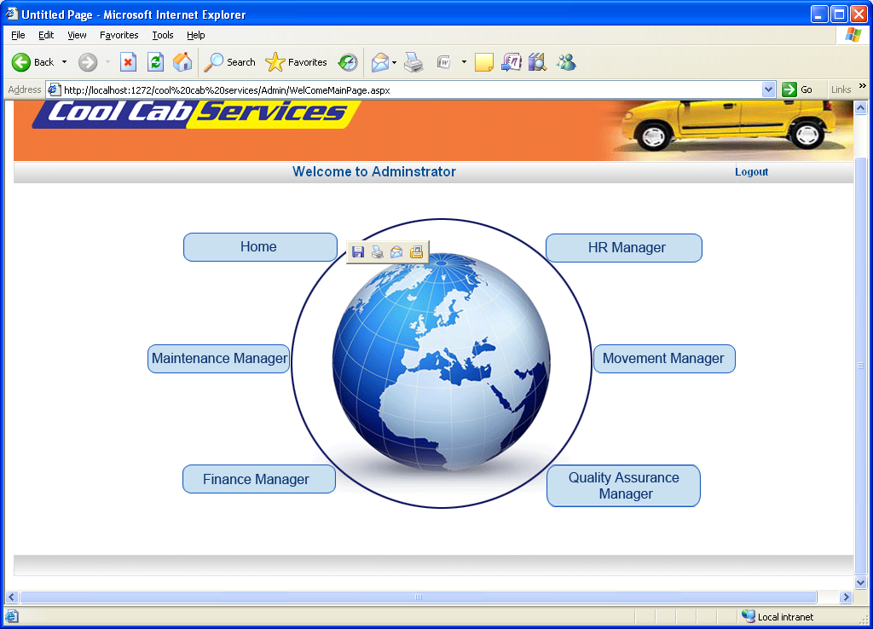

Slide 11
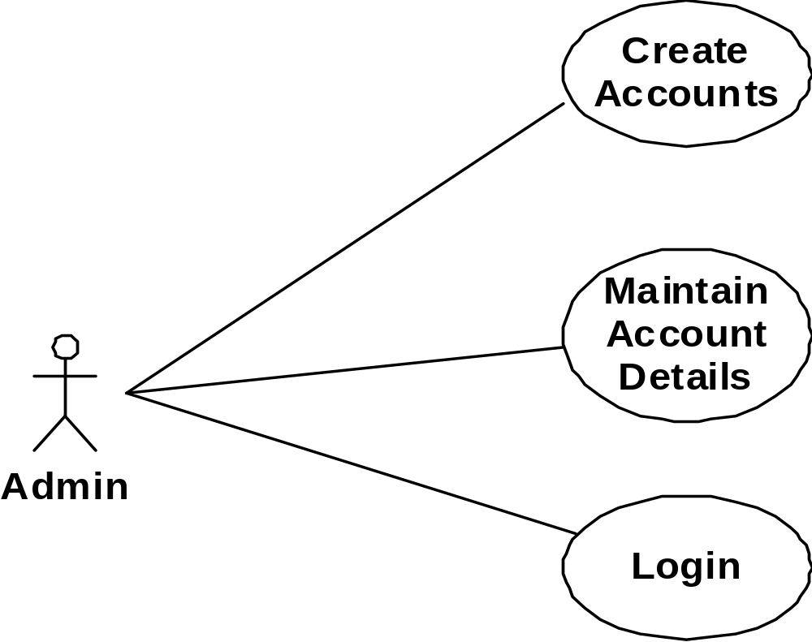
Admin Use Case

Slide 12
HR MODULE
In Real world, Hr manager is responsible for the human resources of employees in an organization.
Here HR is Mainly used to register the employees for the cab facility ,after registering employees, he is the person to make shifts and Batches .Totally the functionalities of HR manager is to Maintain the Employee, Shift details and Batch scheduling.

Slide 13
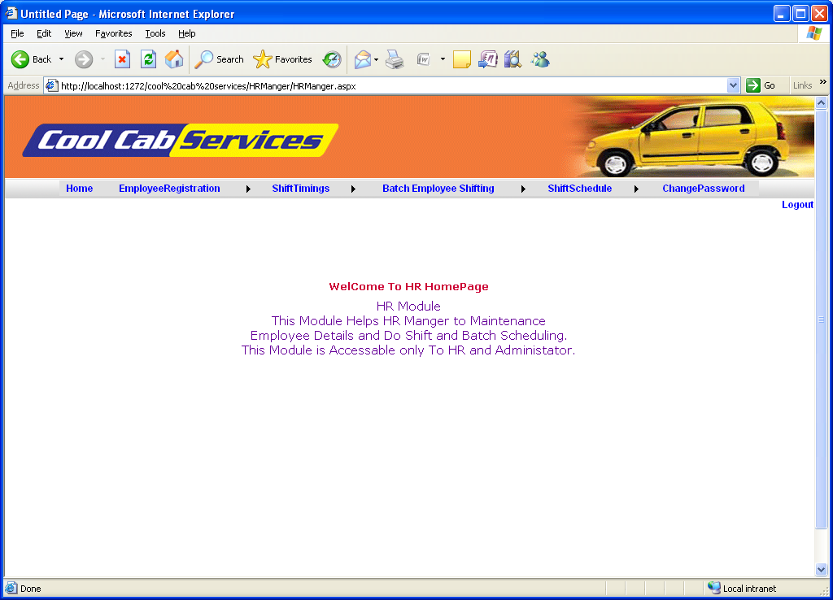

Slide 14
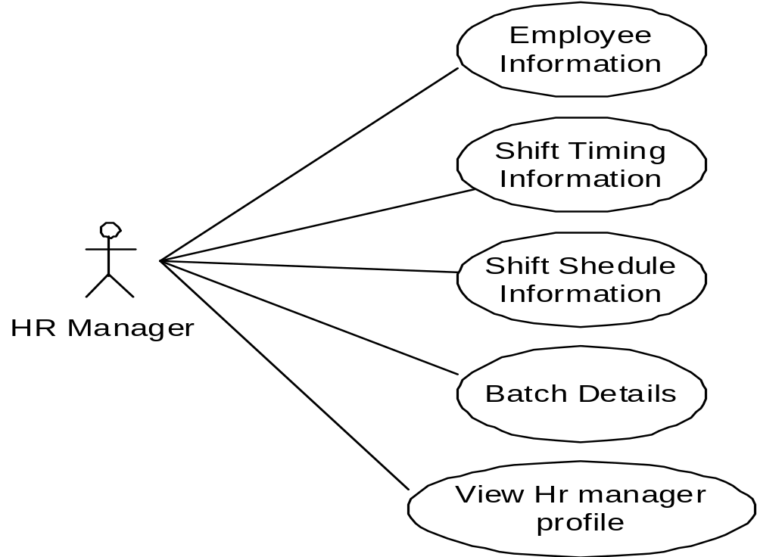
HR Use Case

Slide 15
MAINTENANCE MODULE
Maintenance manager is one of the user in the system.
The main functionalities of this manager is to add vehicles, drivers and vendors of the vehicles.
The Maintenance manager is responsible for the Spare parts billing, registering the vehicles , drivers to the vehicles, mostly the vendor details and date of purchase of vehicles.
These details provide Manager whether the cabs are providing profit or loss.

Slide 16
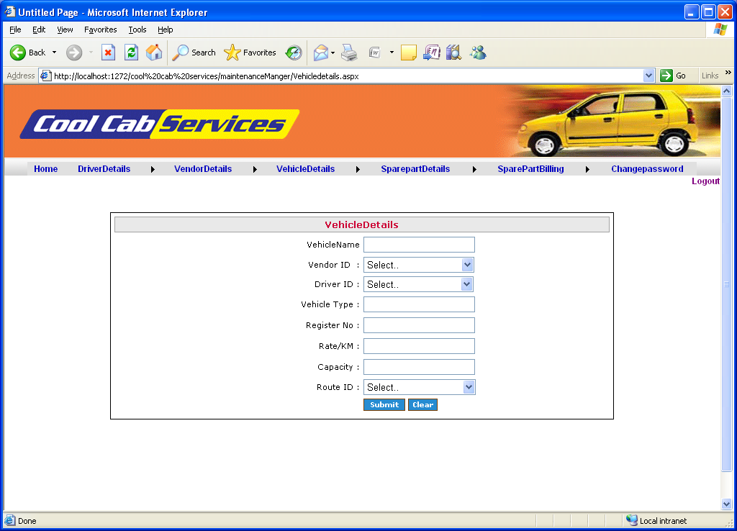

Slide 17
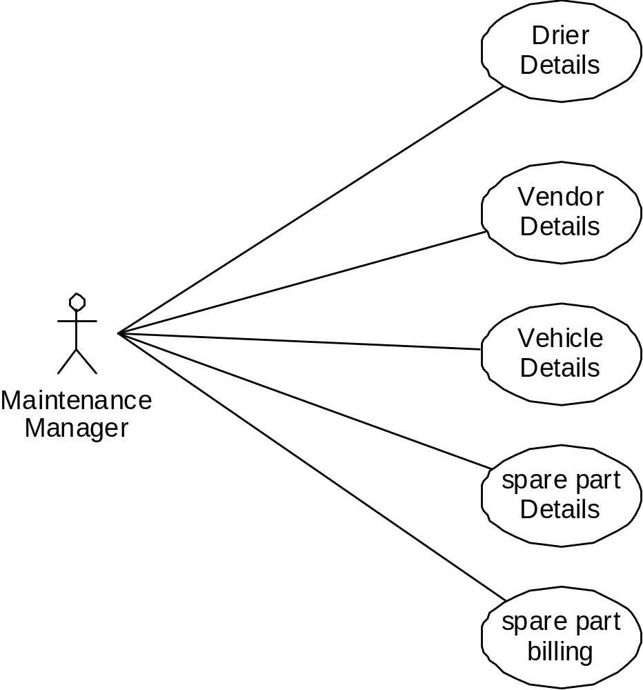
.
Maintenance Use Case

Slide 18
MOVEMENT MODULE
Movement Manager is one kind of user in the system who is responsible for the creation of Driver shift details, route details, vehicle allocation and maintenance of the tripsheets of the Cabs.
Movement manager is not only to create but also responsible for the maintenance of the driver shift details, route details ,trip sheets and Vehicle allocated details.

Slide 19
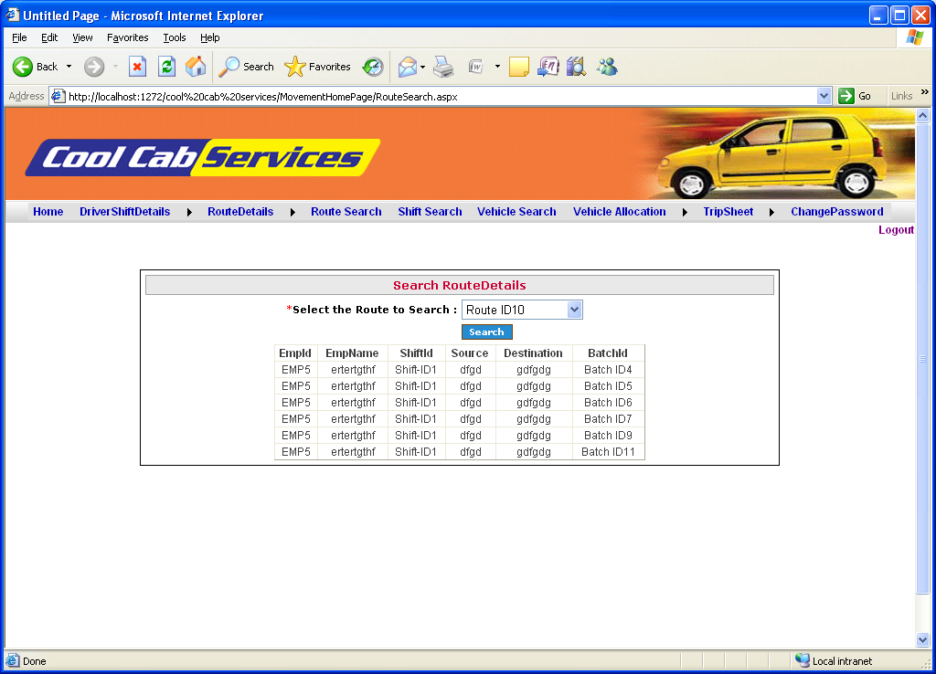

Slide 20
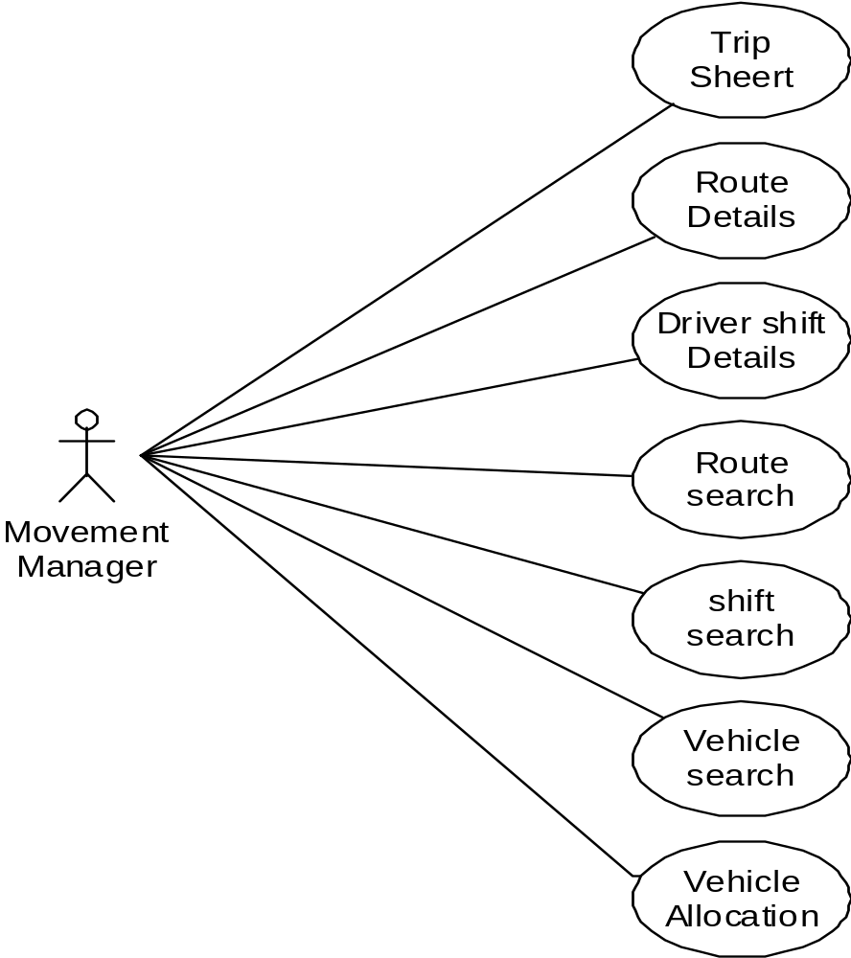
Movement UseCase
.

Slide 21
FINANCE MODULE
He is responsible for the cost estimation of the vendor, vehicle billing and viewing the feedbacks posted by the employees on the events as accidents and the driving nature of a particular cab.
The Feedback posted by employers give the quality and performance of the cabs, by this result managers get a chance to improve the performance of the transportation to get profits.

Slide 22
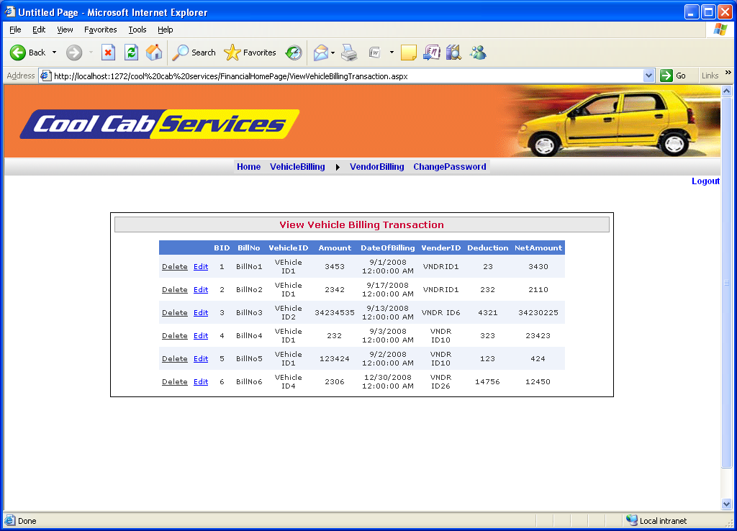

Slide 23
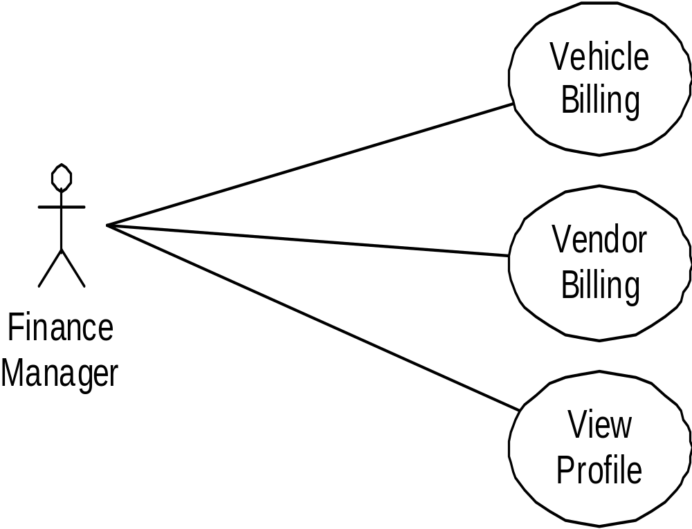
Finance Use Case
.

Slide 24
QUALITY ASSURANCE MODULE
He is responsible for the Maintaining the Quality in the transportation, to provide Quality.
He checks the performance by maintaining the feedbacks from employees and the accident details of the Cab.
Here Quality Assurance Manager is responsible for inserting and maintaining the Accident details, by this details he requests for the finance manager to provide the Amount to the damage .

Slide 25
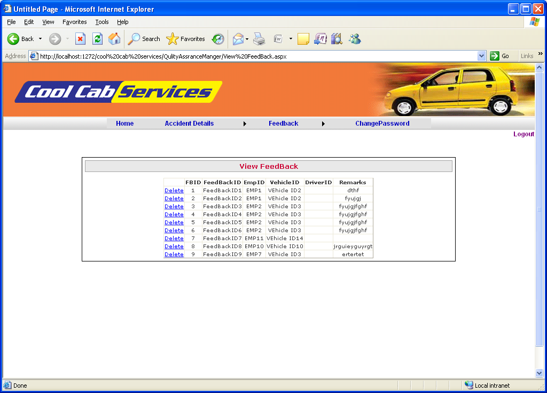

Slide 26
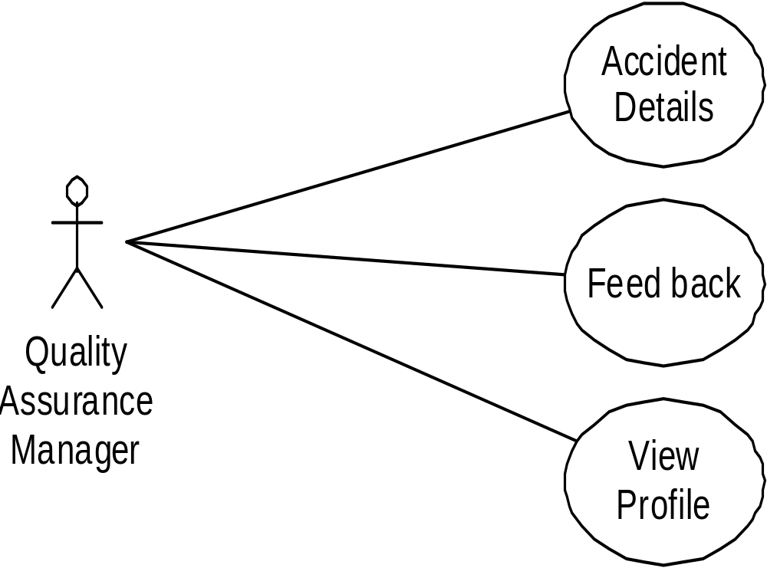
.
QAM Use Case

Slide 27
Data Base
SQL server 2005 used for database
By using this we can create the tables with the details of users
Tbl_AccidentDetails
Tbl_AdminLogin
Tbl_BatchDetails
Tbl_DriverDetails
Tbl_DriverShiftDetails
Tbl_EmployeeDetails
Tbl_FeedBackFrom etc

Slide 28
Sno | columnnumber | datatype | constraint | References
1 | AdminID | varchar(50) | Primary key
2 | UserName | varchar(50) | Not null
3 | PassWord | varchar(50) | Not null
4 | EmailID | varchar(50) | Allow null
5 | Department | varchar(50) | Not null

Slide 29
Conclusion
Cool Cab Services is a Web application and it is restricted to only limited type of users.
In this application different types of managers have been given access rights and they are restricted up to their functionalities, so that the data is maintained securely and redundant data is prevented.
Here The Details of Employees and Drivers, cabs are maintained. But employees are unable to view their details .

Slide 30
Future Improvement
In future our application overcome the flaws if occurred and attain new features offered to employees for the flexible and easy transportation
Following are the enhancements to the application
Provide good user interface
Provide access permission to the employees

Slide 31

Than'Q'

